Slide 1
Tree-based ML DATA624, Spring 2020
Calvin Wong, Murali Kunissery, Omar Pineda

Slide 2
Agenda:
Basic Regression Trees
Regression Model Trees
Bagged Trees
Random Forests
Boosting

Slide 3
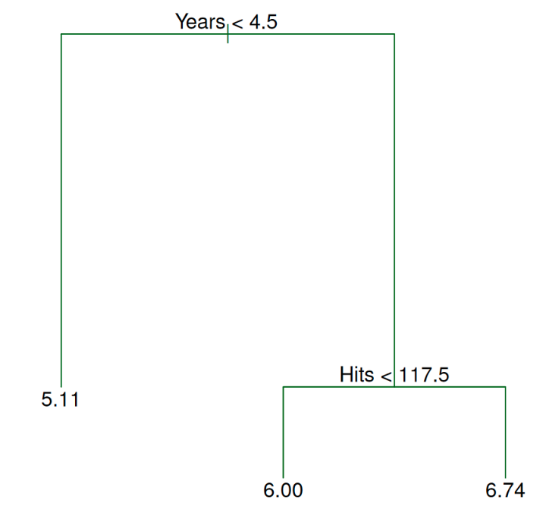
Basic Regression Trees
Tree-based models consist of one or more nested if-then statements for the predictors that partition the data. A model is used to predict the outcome within these partitions.
The final regions are called leaves and the points where the splits occur are nodes.
For basic regression trees, the models in the
nodes are simple averages (constants)
Benefits: highly interpretable, easy to
implement, can handle many predictors without a
a need to pre-process
Challenges: instability, less than optimal predictive
performance, selection bias, these models may not do
a good job predicting samples whose true outcomes are extremely high or low
Notes: We can over-fit if we have too many splits in the tree. If two predictors are highly correlated, the choice of which to use is somewhat random
library(caret)
library(rpart)
rpartTree <- train(y ~ ., data = trainData, method = ‘rpart’)

Slide 4
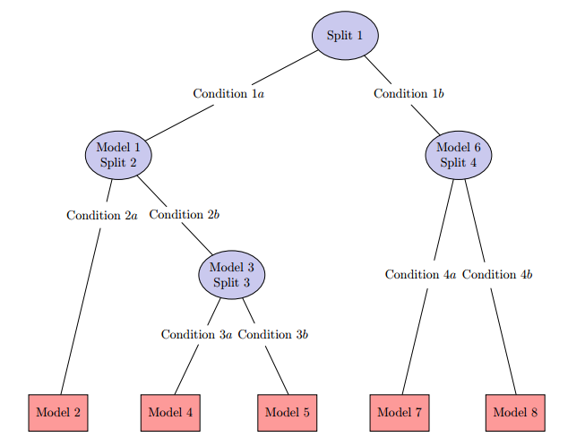
Regression Model Trees
The terminal nodes predict the outcome using
a linear model (as opposed to the simple
average).
When a sample is predicted, it is often a
combination of the predictions from different
models along the same path through the tree.
The split that is associated with the largest
reduction in error is chosen and a linear
model is created within the partitions using the
split variable in the model.
Once the complete set of linear models have been created, each undergoes
a simplification procedure to potentially drop some of the terms.
Also incorporates a type of smoothing to decrease the potential for over-fitting.
Once the tree is fully grown, it is pruned back by finding inadequate subtrees and removing them.
Library(caret)
library(RWeka)
m5tree <- train(y ~ ., data = trainData, method = ‘M5’)

Slide 5
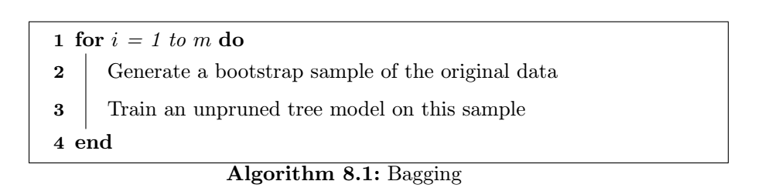
Bagged Trees Introduction
“Bagging predictors is a method of for generating multiple versions of a predictor and using these to get an aggregated predictor”
Leo Breiman, University of California
Bagging Predictors – September 1994
Bootstrap Aggregation aka “Bagging“

Slide 6
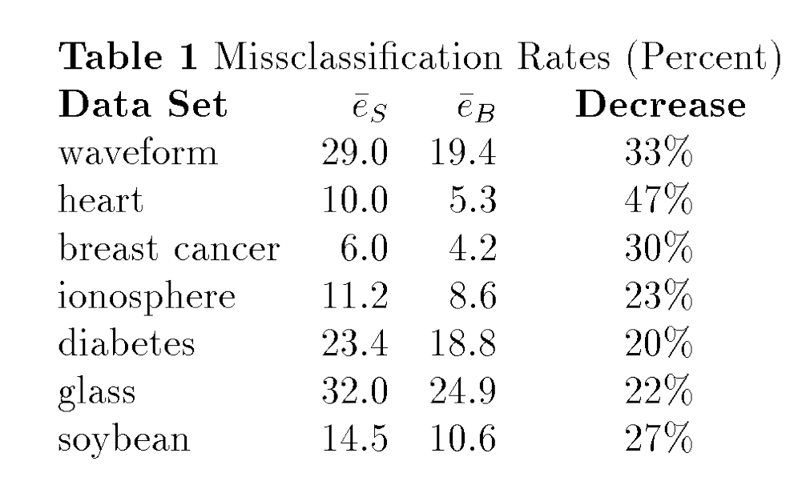
Why use bagging
Bagging effectively reduces the variance of a prediction through its aggregation process
For models that produce an unstable prediction, bagging reduces the variance in the prediction
Breiman states that we can see a reduction in test set misclassification rates from 20% to 47%

Slide 7
Why use bagging
Bagging models can provide their own internal estimate of predictive performance that correlates well with either cross-validation estimates or test set estimates
Out-of-bag can be used to assess the predictive performance of that specific model
Out-of-bag estimate

Slide 8
Conditions
Bagging can push a good but unstable procedure a significant step towards optimality, however, can degrade the performance of stable procedures
Computational costs and memory requirements increase as the number of bootstrap samples increases
Bagged model is much less interpretable than a model that is not bagged

Slide 9
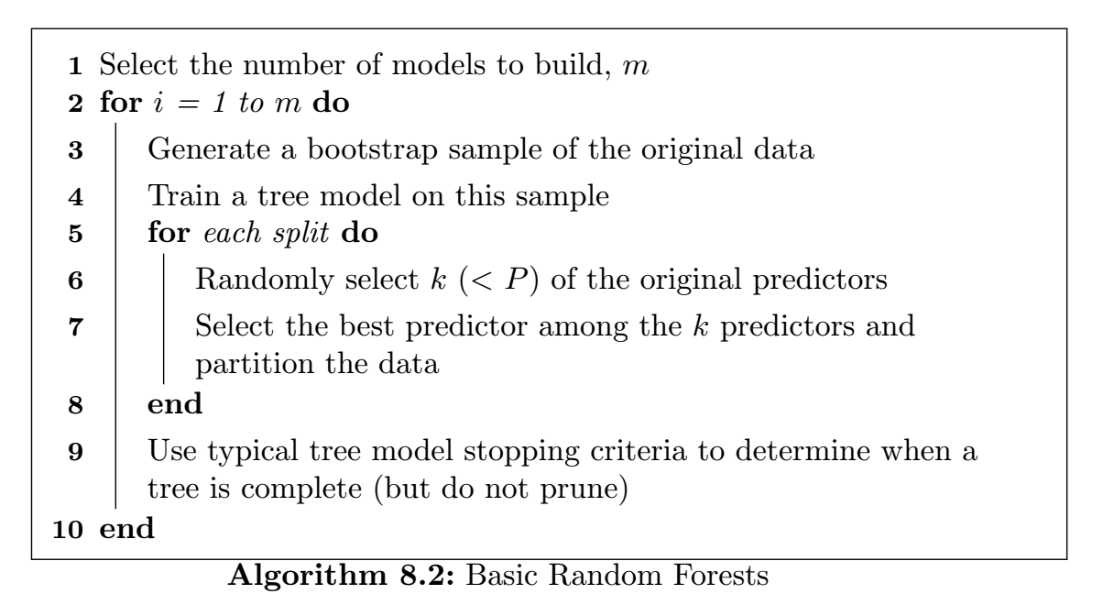
Random Forest Introduction
Reducing correlation among trees, known as de-correlating trees, is then the next logical step to improving the performance of bagging
Through multiple attempts of generalization the original bagging algorithm, in 2001, Breiman constructed a unified algorithm called random forests

Slide 10
Why use Random Forest
With bagging, the trees are not completely independent of each other since all of the original predictors are considered at every split of every tree
Reducing correlation among trees, known as de-correlating trees, is then the next logical step to improving the performance of bagging.
Compared to bagging, random forests is more computationally efficient on a tree-by-tree basis since the tree building process only needs to evaluate a fraction of the original predictors at each split

Slide 11
Conditions
The larger the forest, the better the results
a starting point, the authors suggest using at least 1,000 trees. If the cross-validation performance profiles are still improving at 1,000 trees, then incorporate more trees until performance levels off
The ensemble nature of random forests makes it impossible to gain an understanding of the relationship between the predictors and the response. However, because trees are the typical base learner for this method, it is possible to quantify the impact of predictors in the ensemble.

Slide 12
Boosting: - A quick history of its evolution.
Boosting models were original developed for classification problems
AdaBoost provides a practical implementation of boosting a weak learner to a strong learner.
AdaBoost was a powerful prediction tool and was widely adopted in applications with gene expressions
Further research enabled boosting to be interpreted as a forward stagewise additive model that minimizes exponential loss
The new research enabled the method to be extended to regression problems
Evolved from AdaBoost Algorithm to Friedman’s stochastic gradient boosting machine which encompasses both classification and regression.

Slide 13
Boosting: - Basic Principle
Given a loss function ( e.g..squared error for a regression) and a weak learner (e.g.. regression trees ) , the algorithm seeks to find an additive model that minimizes the loss function.
The algorithm is typically initialized with the best guess of the response (e.g., the mean of the response in regression). The gradient (e.g., residual) is calculated, and a model is then ﬁt to the residuals to minimize the loss function
The current model is added to the previous model and the procedure continues for a specified number of iterations.

Slide 14
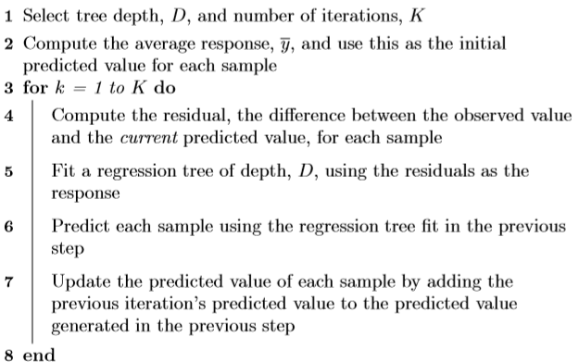
Boosting: - Algorithm & Diff with Random forest
Random Forest – All trees created independently Each tree has max depth Each tree contributes equally to final model Can be parallelly processed for better computation time Gradient Boosting – Dependent on past trees Have minimum tree depth Contributes unequally to final model Cannot be parallelly processed

Slide 15
Boosting : - Overfitting & Regularization
The gradient booting machine could be susceptible to over fitting .
Despite using weak learners, boosting still employs the greedy strategy of choosing the optimal weak learner at each stage.
A remedy for that is to constrain the learning process by employing regularization, or shrinkage
In the previous algorithm shown, Instead of adding the predicted value for a sample to previous iteration’s predicted value, only a fraction of the current predicted value is added to the previous iteration’s predicted value
This fraction is commonly referred to as the learning rate and is parameterized by the symbol, λ.
This parameter can take values between 0 and 1 and becomes another tuning parameter for the model
that the value of the parameter is inversely proportional to the computation time required to ﬁnd an optimal model

Slide 16
Questions?

